Slide 1
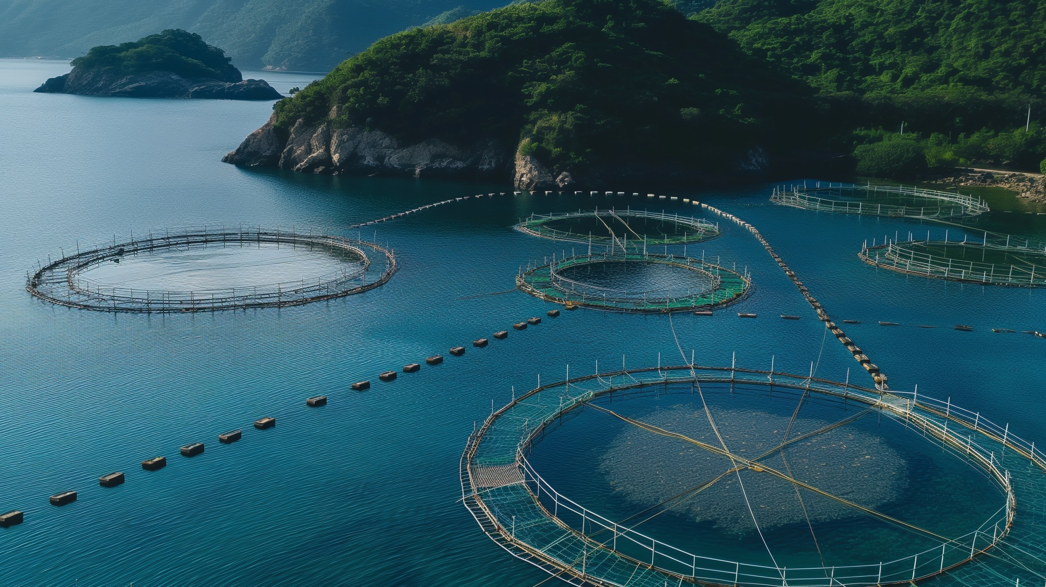
10 MINUTE PITCH DECK
ESSENTIALS
CLARIFY | TEACH | INSPIRE Nature based aquaculture led start ups

Slide 2
10 MINUTE PITCH ESSENTIAL SLIDES
You only have 10 Minutes to present. We want you to prioritise clarity, excitement, and credibility, without diving too deep into financials or granular projections.
You’ll want to keep your presentation to about 7 key slides max.
https://enaca.org/aquainnovate

Slide 3
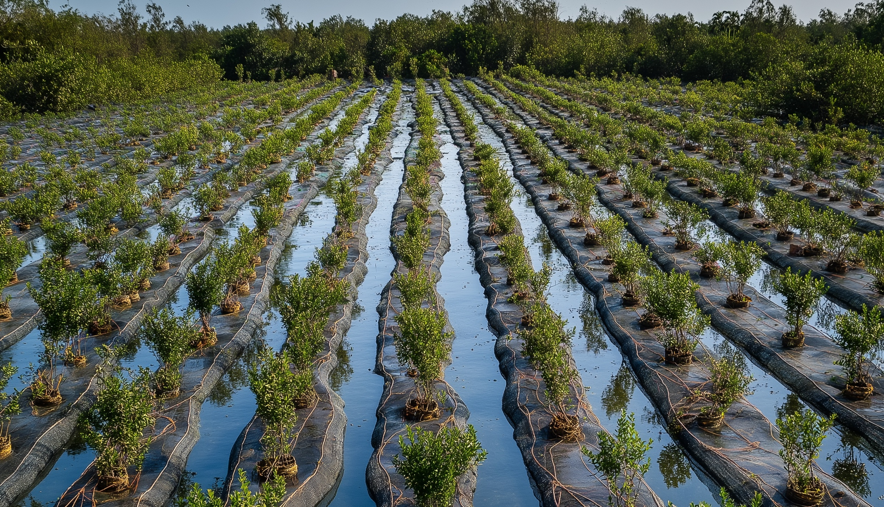
1 COVER SLIDE
Set the tone, show professionalism, grab attention
MANGROVES MAKE BETTER SHRIMP
Include
Logo | Company Name and
Tagline
Sustainably farmed shrimp, powered by nature's best coastal defense.
Conventional farms pollute. Ours regenerate.
Dynamic Image or Visual
Preferably from your innovation, location, iconic branded image
Hook Us In
Make it obvious in 10 seconds what you're building and for whom.
Think tagline + tension.

Slide 4
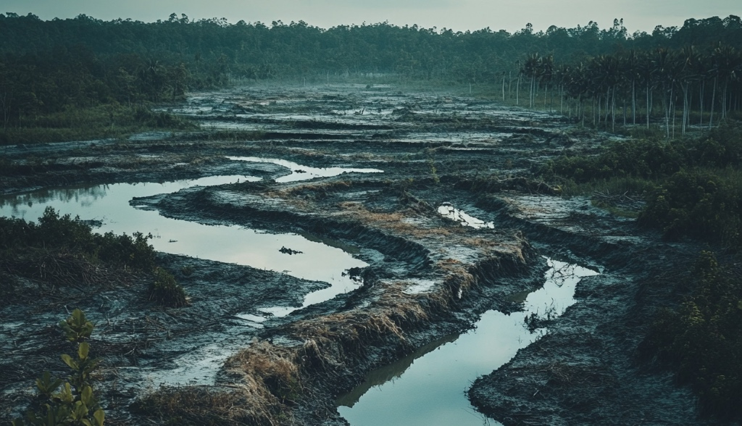
2 STATE THE PROBLEM SLIDE
Build empathy and relevance
Conventional Shrimp Farming is devastating coastal ecosystems
Strong Statement 1 Strong Image Dark Background
Over 38% of global mangrove deforestation has been directly linked to shrimp farming practices. (Source: UNEP, 2021)
Use one powerful stat/data point Keep it simple and compelling.
Rapid loss of coastal protection from storms and flooding
Water pollution and disease spread due to chemical-laden effluent
Sharp decline in biodiversity and local fish nurseries
Add 3 Impact Results in Bullet Points

Slide 5
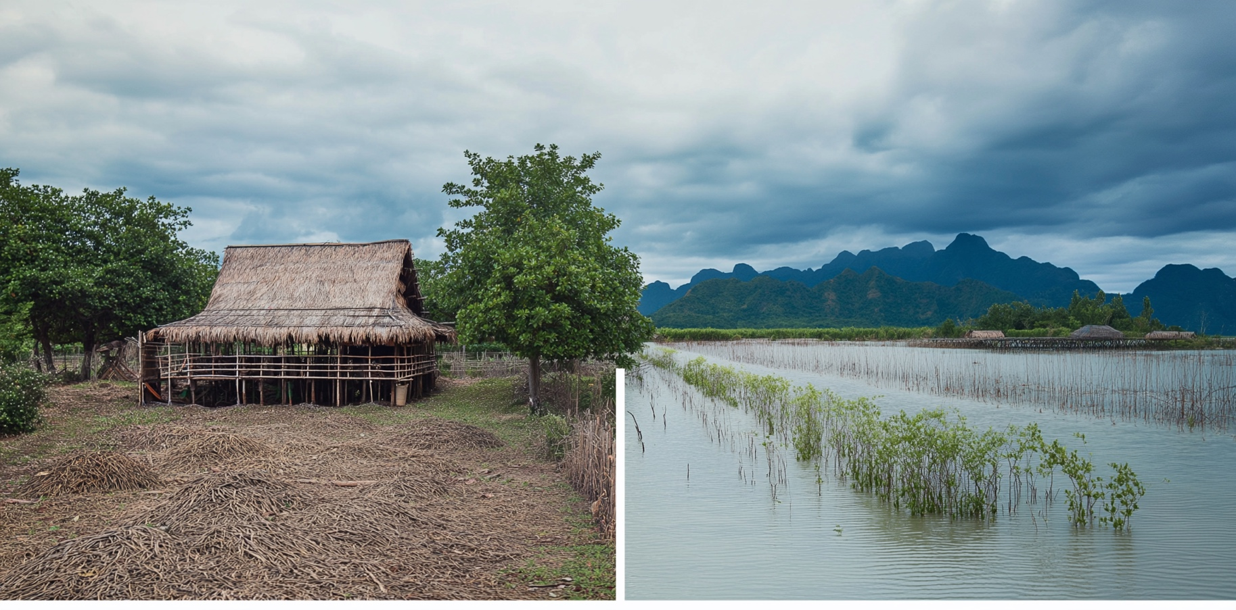
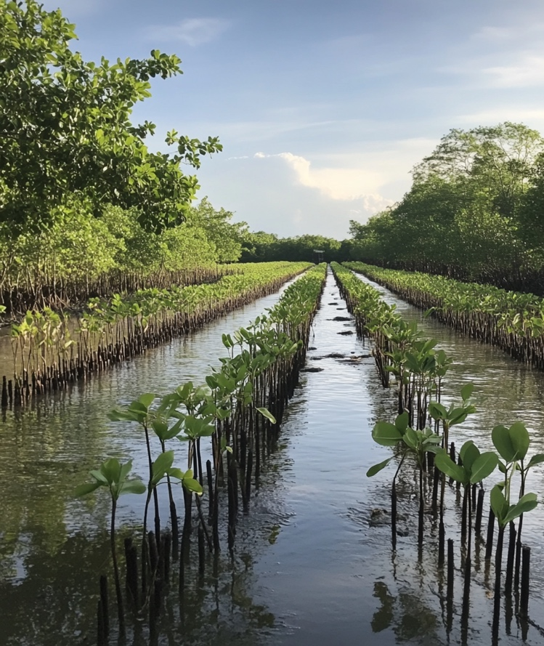
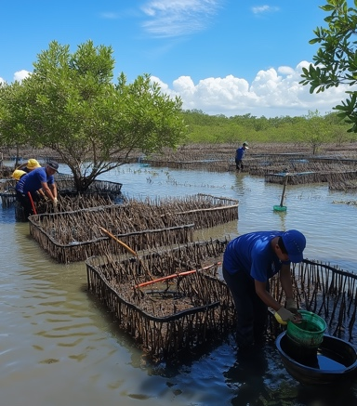
3 YOUR SOLUTION SLIDE
Clearly show what you are offering and why it matters
Mangrove Shrimp: Harmonising Aquaculture with Nature
BEFORE
AFTER
Headline
Grows premium shrimp inside thriving, restored mangrove farms.
Use a split screen image/ side by side or a good before and after image.
Boosts marine biodiversity while purifying waters naturally.
3 Bullet points that amplify the “WHY”
Empowers coastal communities with regenerative shrimp farming and year round incomes

Slide 6
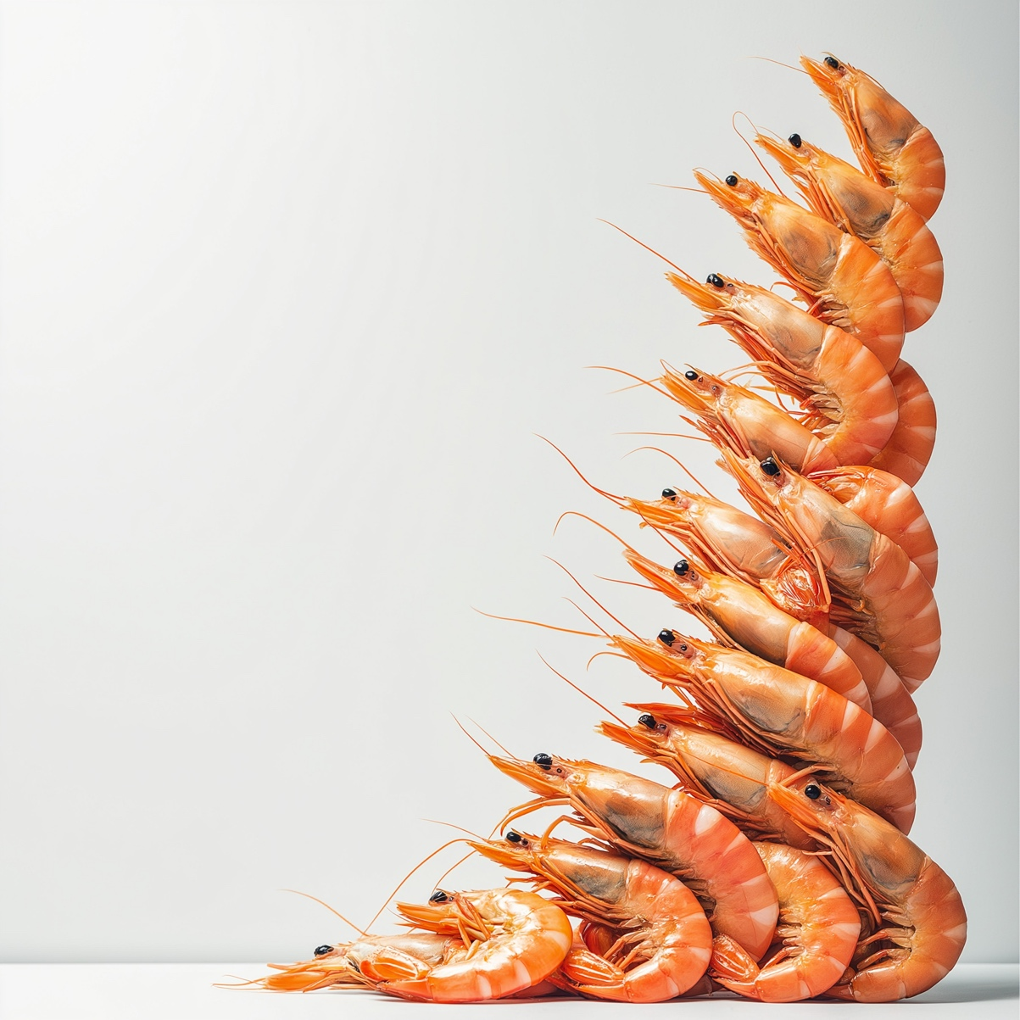
4 MARKET OPPORTUNITY SLIDE
Show that this matters at scale
Notes you can speak to when explaining the market opportunity slide
TAM $45B of that is shrimp — the single most valuable seafood commodity worldwide
TAM Total Addressable Market
Rising Demand for Sustainable Seafood
$300B global seafood market
$45B of that is shrimp
SAM Dialogue: Notes (projected to grow 12% annually) Driven by major retailers adopting strict sourcing policies
SAM Serviceable Available Market
$9B in demand for certified sustainable shrimp
$300M+ eco-certified shrimp share
SOM obtainable share from Thailand alone. Based on our ability to serve niche markets (organic, low-impact, mangrove-restored) across 5–10% of premium demand in Europe and North America.
SOM Serviceable Obtainable Market
Source:
TAM: FAO
SAM: Future Market Insights, 2024
SOM: WWF Shrimp Pathway Estimates, 2023

Slide 7
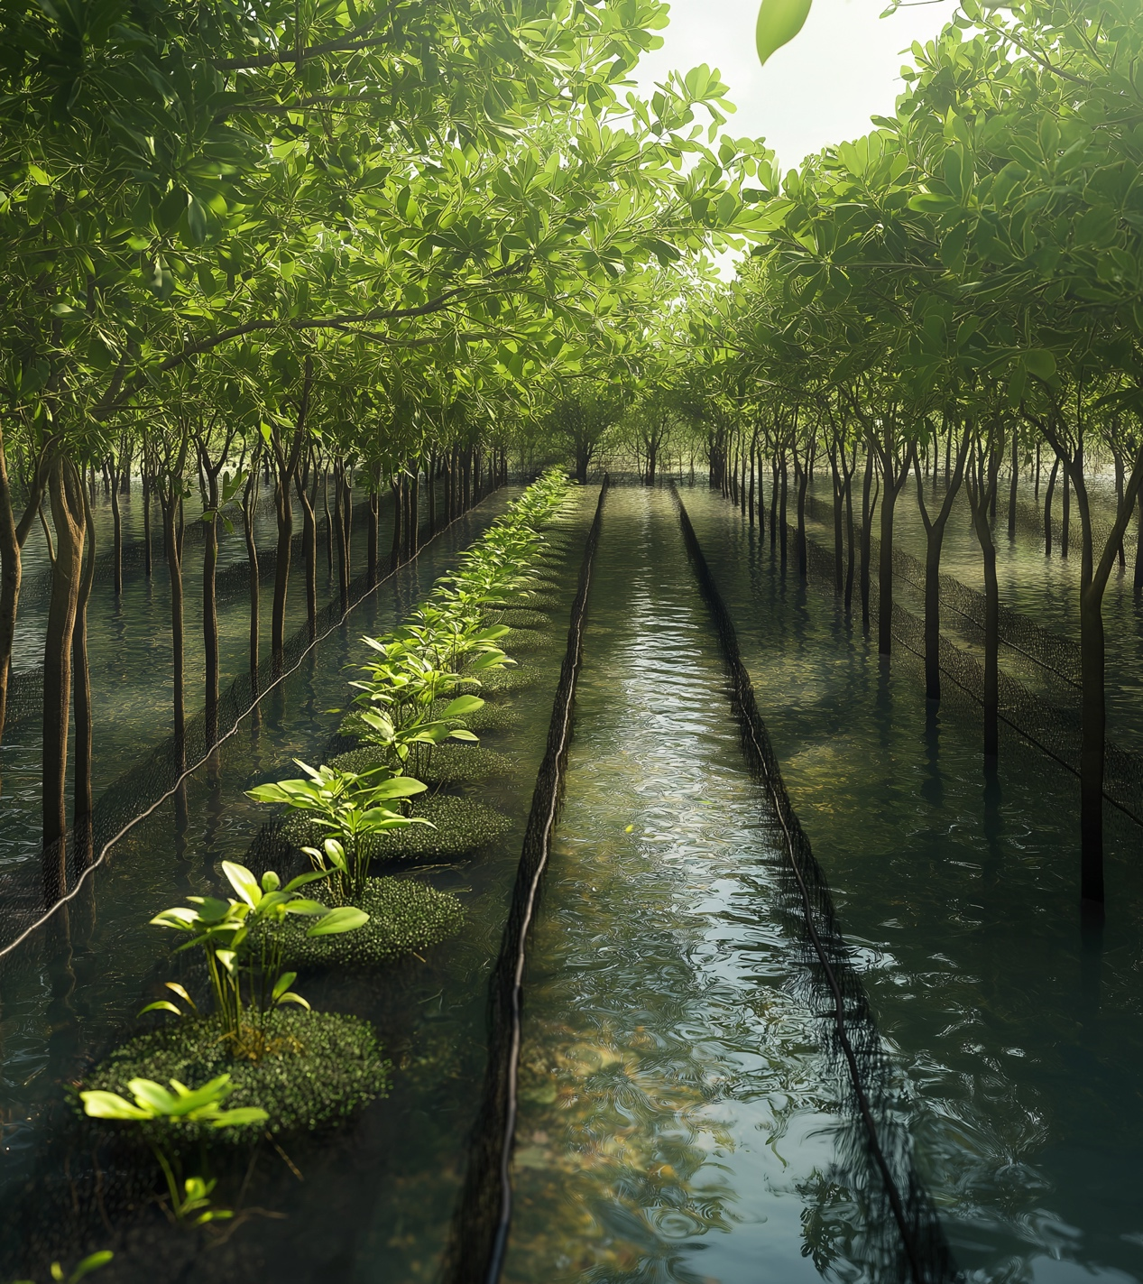
5 HOW IT WORKS SLIDE
Give credibility and differentiate
How it works: Nature-Engineered Shrimp Farming Redefined
Is it patented, proprietary or hard to replicate?
Highlight innovation, R&D or Technical Partnerships
Bio-loop mangrove zones Native mangroves planted in smart clusters restore balance
Living water trenches Natural root filtration cleans pond water continuously
Microfeed & gentle harvesting Algae-based feeds and net-free harvests protect shrimp health
Give credibility & differentiate
Include: Only one diagram schematic / flow diagram or one visual- strong product screenshot or case image

Slide 8
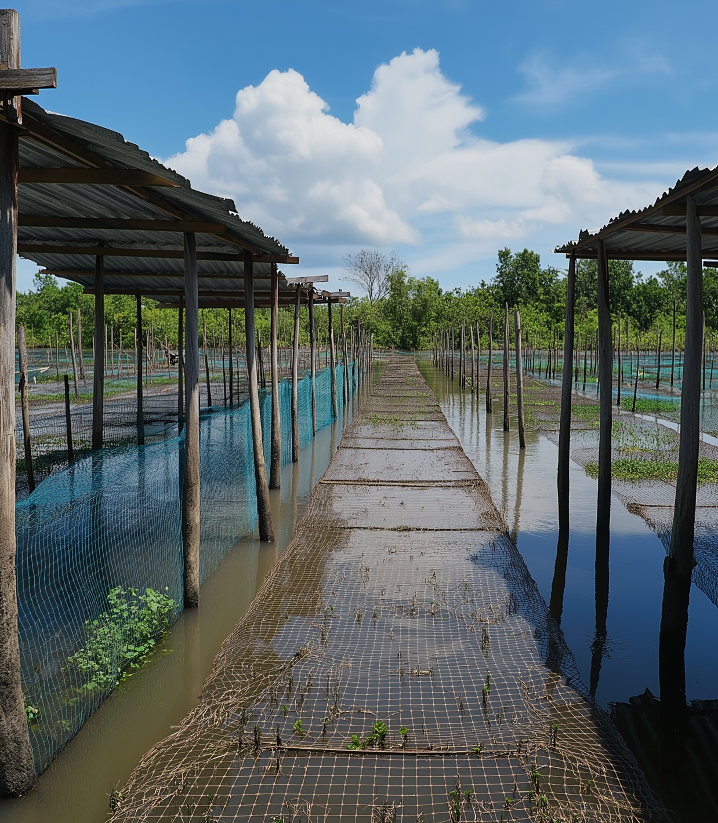
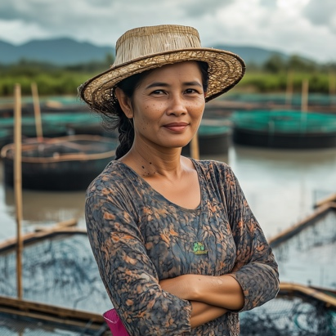
Promising Results from Pilot Projects
OUTCOMES
6 EARLY TRACTION SLIDE
Show progress and momentum- even at an early stage
Showcase the results of your insights through growth and customer love.
We finally feel like shrimp farming is working with nature, not against it. Somsri Kanchana, Local cooperative leader, Nakhon Si Thammarat
Captivate your audience with attention-
Grabbing key metrics or a timeline showing traction so far and what’s next is very effective.
Promising Results from Pilot Projects
2025
30% increase in shrimp survival rates
Key Metrics Pilot results revenue to date, units sold, farms onboarded, grants received, logos of partners and clients.
Show that you have done the math for your innovation.
2024
42% decrease in ammonia levels 28% drop in disease outbreaks (white spot & EMS)
2023
92% report stronger livelihoods from year-round farming and restored ecosystems.

Slide 9
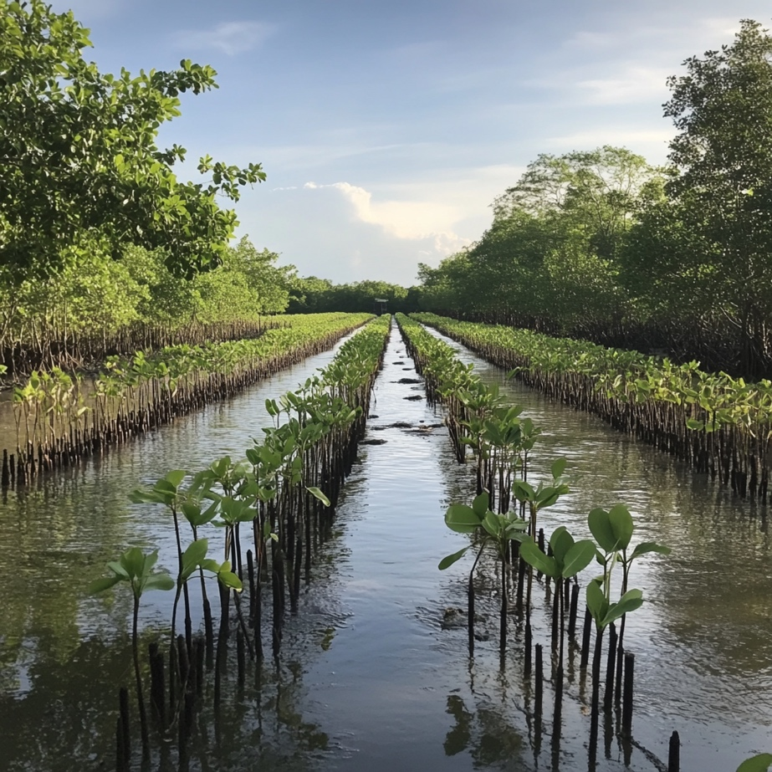
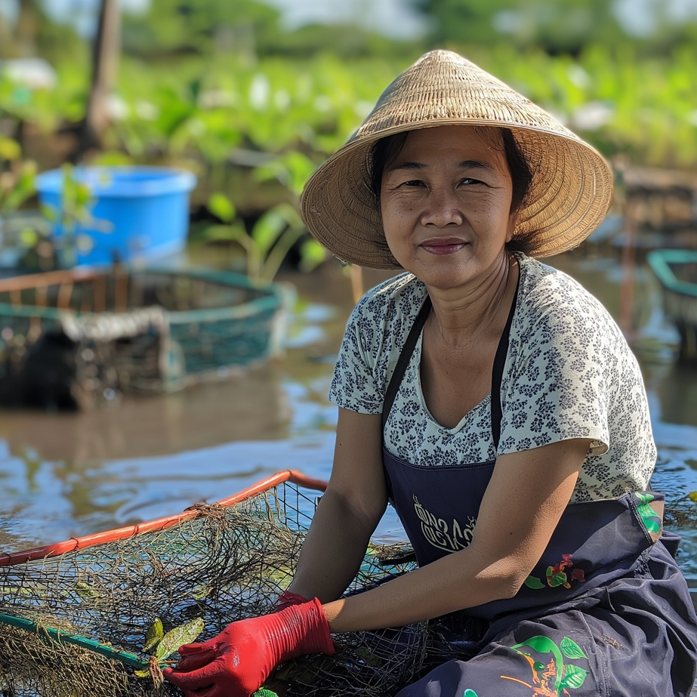
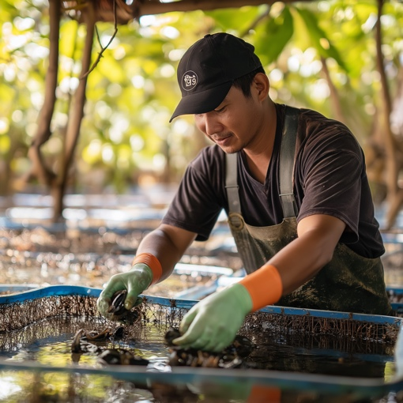
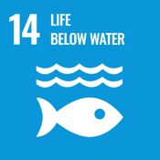
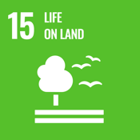
7 NbS IMPACT SLIDE
Reinforce the broader “why” - important for policy, NGO development and commercial audiences…
Quantify your impact (e.g., kg CO₂ saved, % disease reduction - be specific. Use bullet points on this slide to highlight specific, niche impacts.
Nature-Led Farming That Revives Ecosystems and Empowers Communities
Use Impact Icons
SDGs 14 & 15 habitat restoration, species return, and sustainable land use
Replanted over 10,000 mangroves in degraded coastal zones
Created stable income streams for 100+ small-scale farmers
Add SDG Logos

