Slide 1
Design a clear, compelling A3 snapshot. Prioritise visuals (images, diagrams), keep text minimal, specific, and niche. You can adjust design however all sections must be included.
INNOVATION NAME / TITLE
ADD YOUR LOGO HERE
SLIDE 1 WORDING STRONG ONE LINER TAGLINE HERE
SLIDE 2 CLEAR PROBLEM STATEMENT
SLIDE 3 SOLUTION IMAGE / SHORT INFO HERE
SLIDE 4 MARKET OPPORTUNITY
SLIDE 6 EARLY TRACTION SLIDE
SLIDE 5 HOW IT WORKS SLIDE
SLIDE 7 NBS IMPACT SLIDE
TEAM | PERSONNEL | KEY CONTACT/S
Contact Full Name
Title email contact
Contact Full Name
Title email contact
YOUR WEBSITE
HOW DO WE BEST CONTACT YOU TO FIND OUT MORE

Slide 2
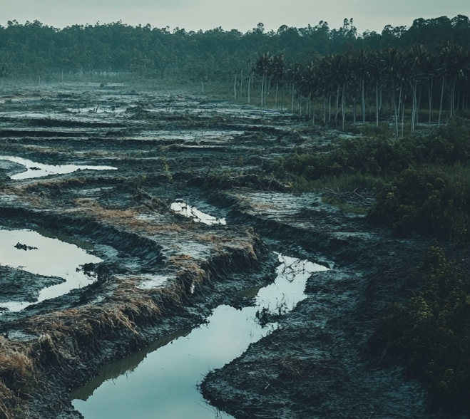
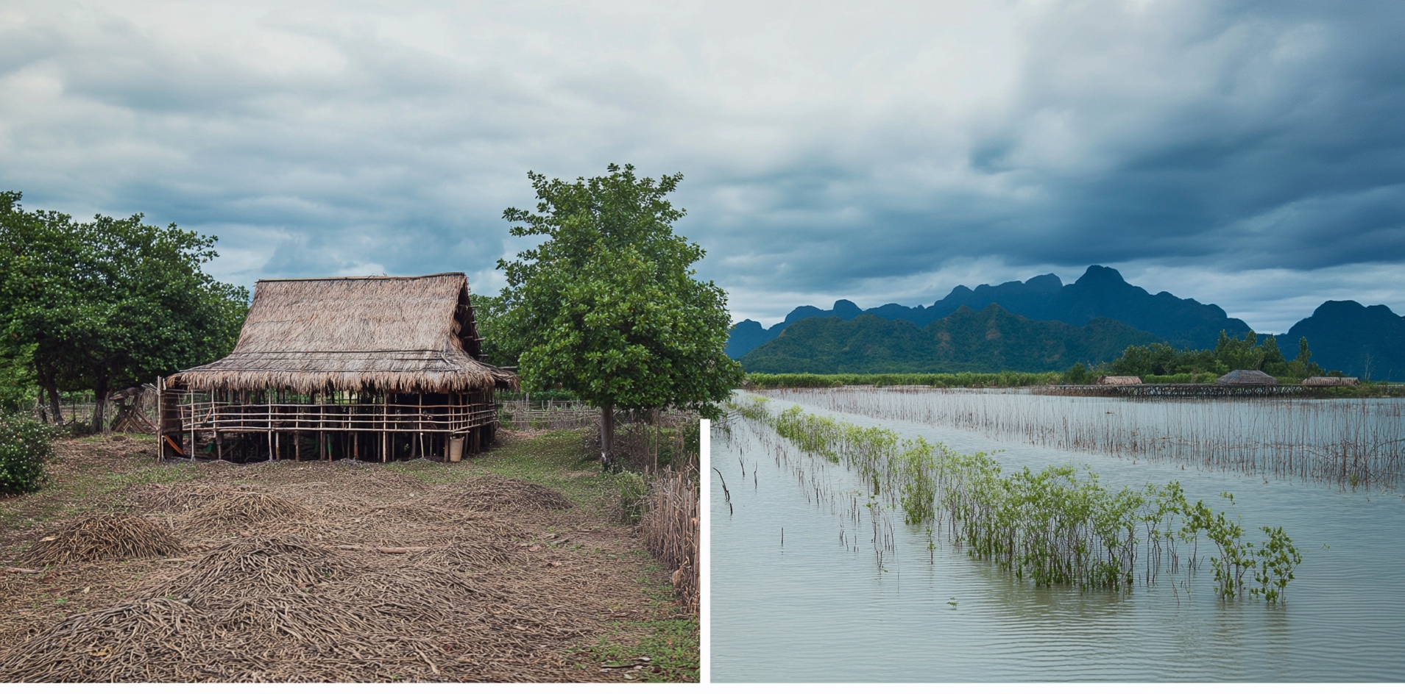
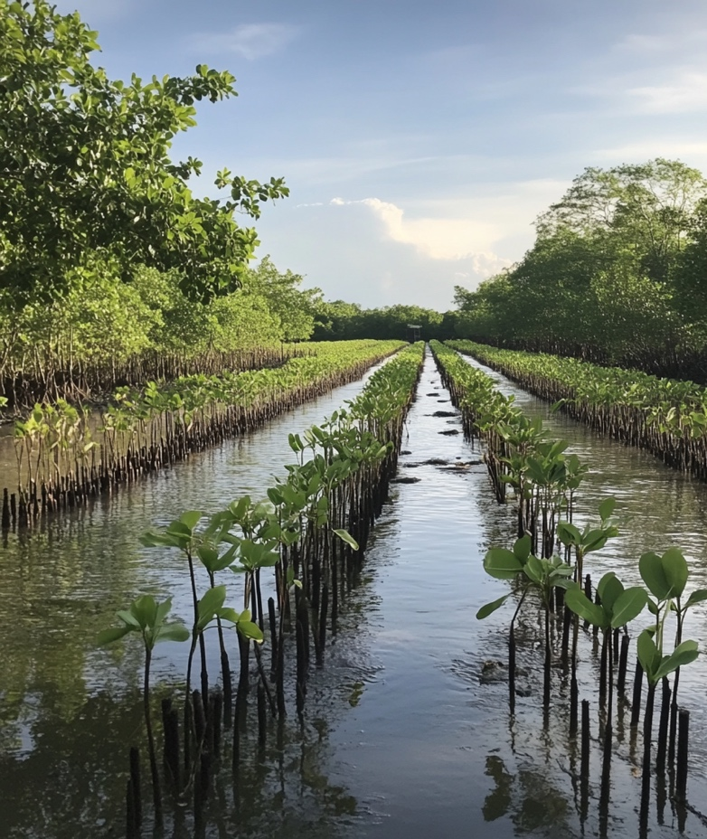
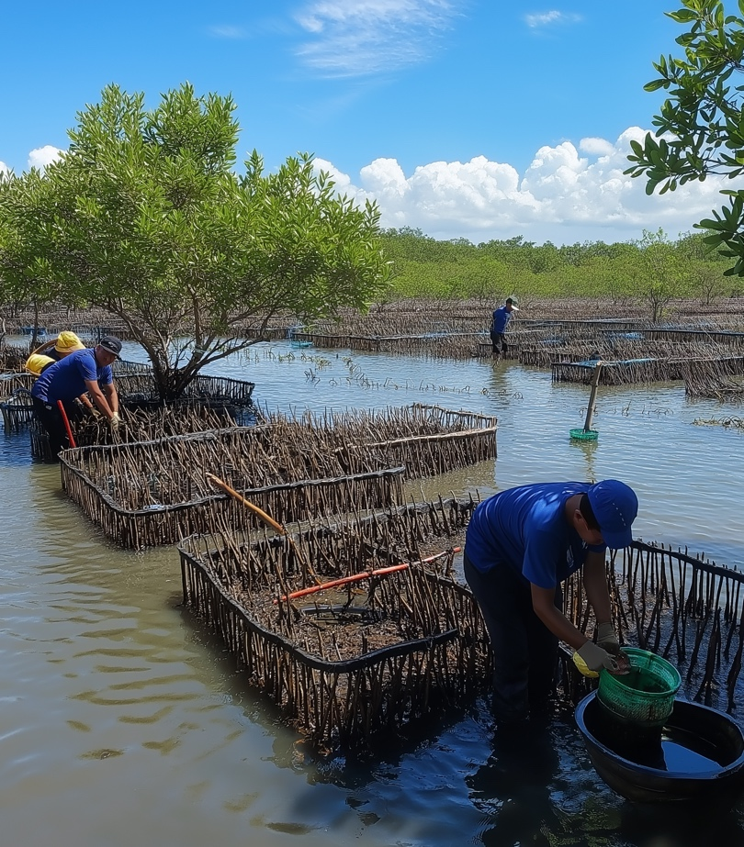
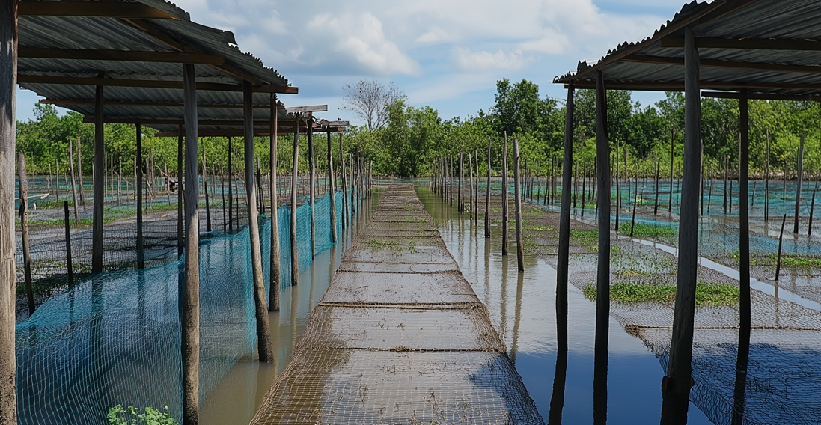
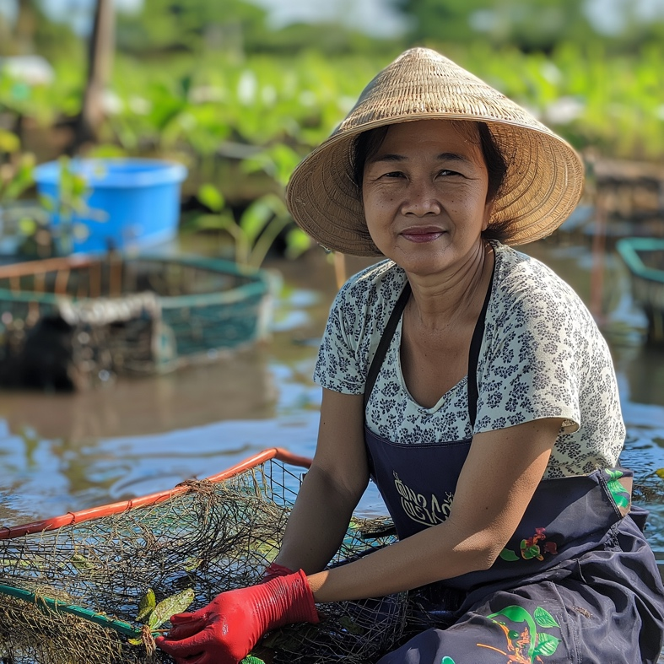
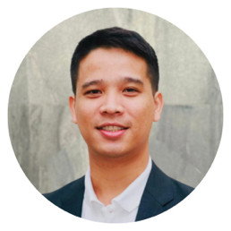
MANGROVES MAKE BETTER SHRIMP
MANGROVE SHRIMP CO
Sustainably farmed shrimp, powered by nature's best coastal defense.
Conventional shrimp farming is devastating coastal ecosystems
OUR SOLUTION
Harmonising shrimp aquaculture with nature
Over 38% of global mangrove deforestation has been directly linked to shrimp farming practices. (Source: UNEP, 2021)
OUR MARKET OPPORTUNITY
$300B
TAM: $300B global seafood market
$45B of that is shrimp
SAM: $9B in demand for certified sustainable shrimp
SOM: $300M+ eco-certified shrimp share
$9B
BEFORE
AFTER
$300M+
Promising results from our Pilot projects
2025
30% increase in shrimp survival rates
HOW IT WORKS
2024
42% decrease in ammonia levels 28% drop in disease outbreaks (white spot & EMS)
Bio-loop mangrove zones Native mangroves planted in smart clusters restore balance
Living water trenches Natural root filtration cleans pond water continuously
Microfeed & gentle harvesting Algae-based feeds and net-free harvests protect shrimp health
2023
92% report stronger livelihoods from year-round farming and restored ecosystems.
Replanted over 10,000 mangroves in degraded coastal zones
Created stable income streams for 100+ small-scale farmers
SDGs 14 & 15 habitat restoration, species return, and sustainable land use
OUR MANGROVE SHRIMP LEADS
Niran Warin, Business Director Principal Investment Manager
niran@mangroveshrimp.com
Christine Maxwell, Programme Director
christine@mangroveshrimp.com
MANGROVE SHRIMP CO
mangroveshrimp.com

